Slide 1

Playing Video Game – Deep Reinforcement Learning Deep Q-Networks
Tianshi Xie
Computer Science Dept.
Troy University

Slide 2
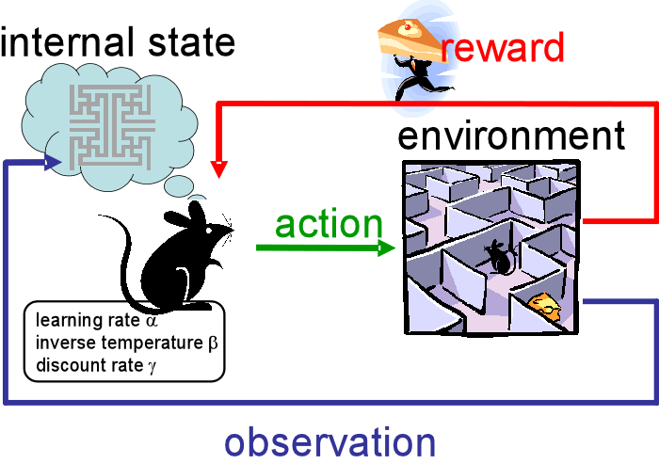
Abstract

Slide 3
Main Frame
How does the game and DQN interact?
How does the DQN work?

Slide 4
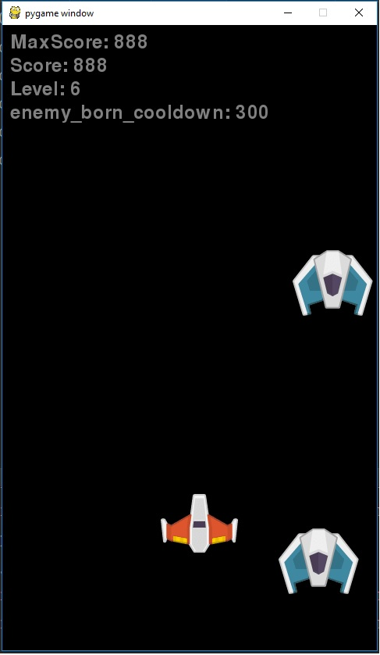
Demo
DQN_human
DQN_ROBOT
(less than 1 hour)
DQN_ROBOT
(over 30 hour)

Slide 5
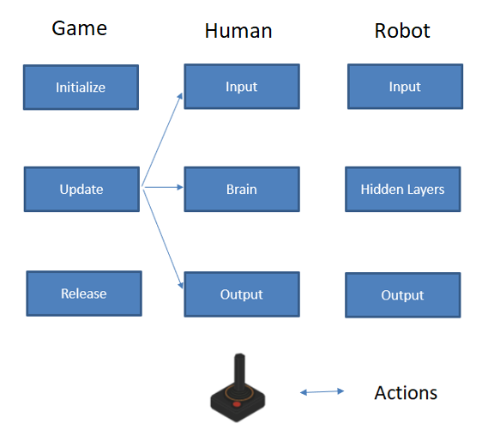
How does the game and DQN interact?

Slide 6
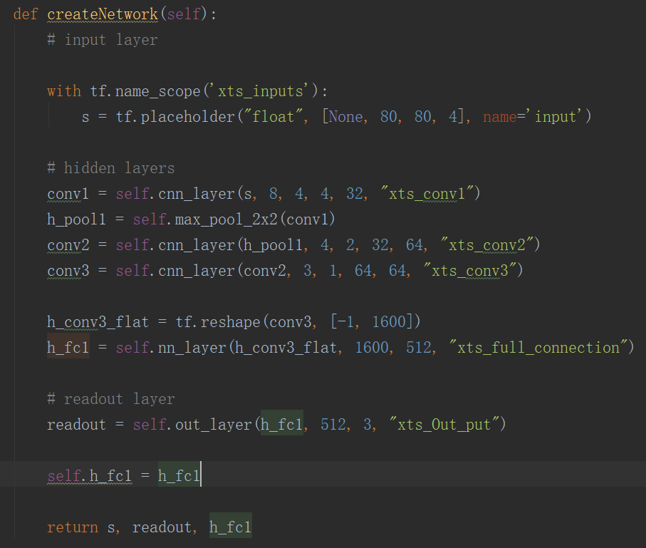
How does the DQN work

Slide 7
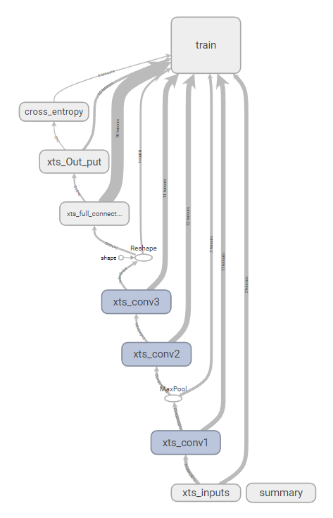
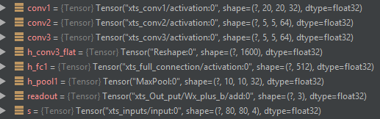
Visualization Tools - TensorBoard

Slide 8
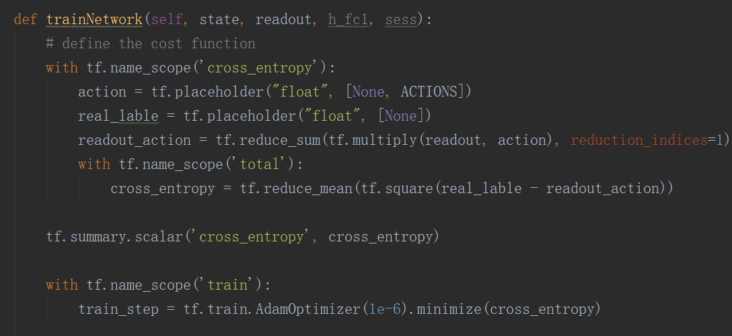
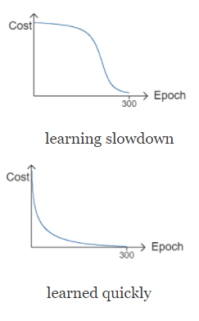
Trainning Neural Network

Slide 9
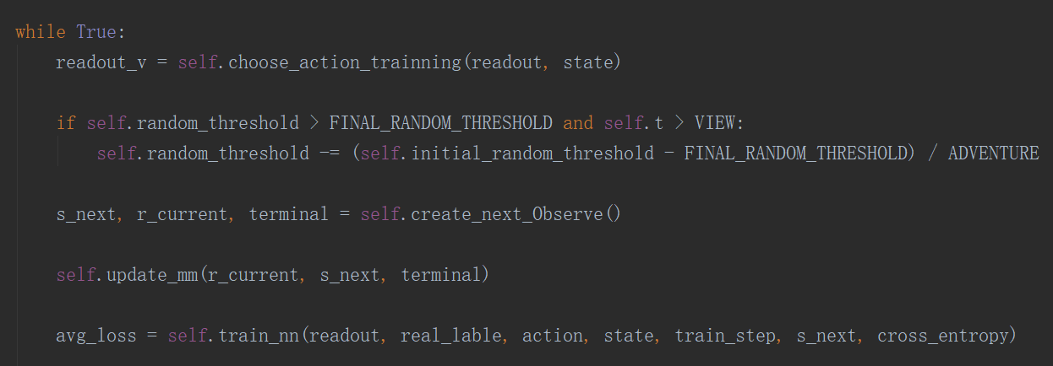
Trainning Neural Network

Slide 10
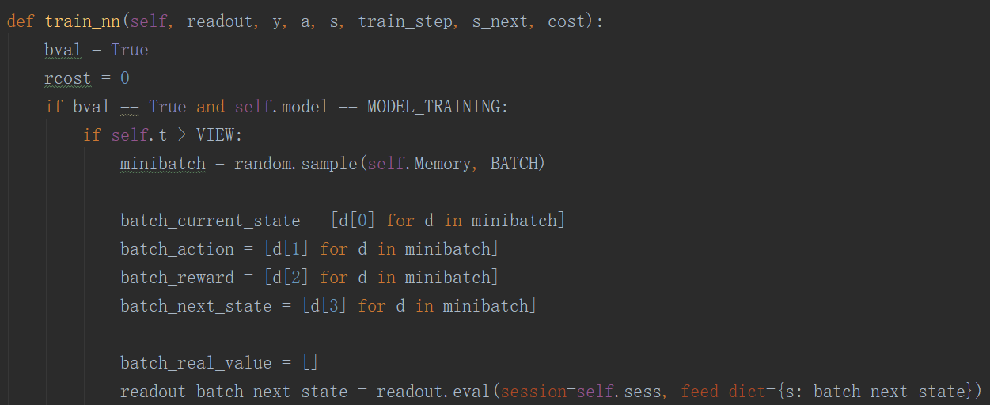
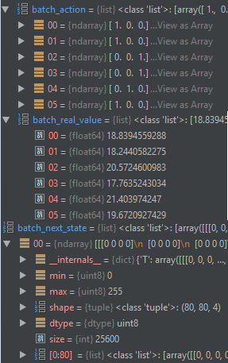
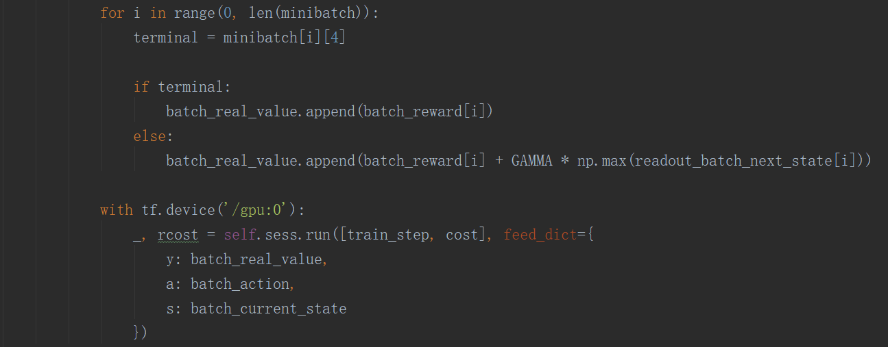
Trainning Neural Network
Figure 3

Slide 11
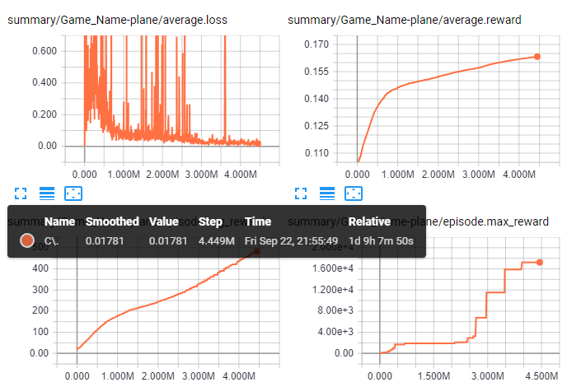
Visualizing the Value Function

Slide 12
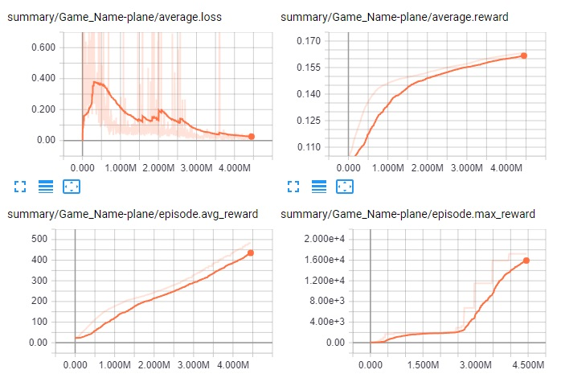
Visualizing the Value Function

Slide 13
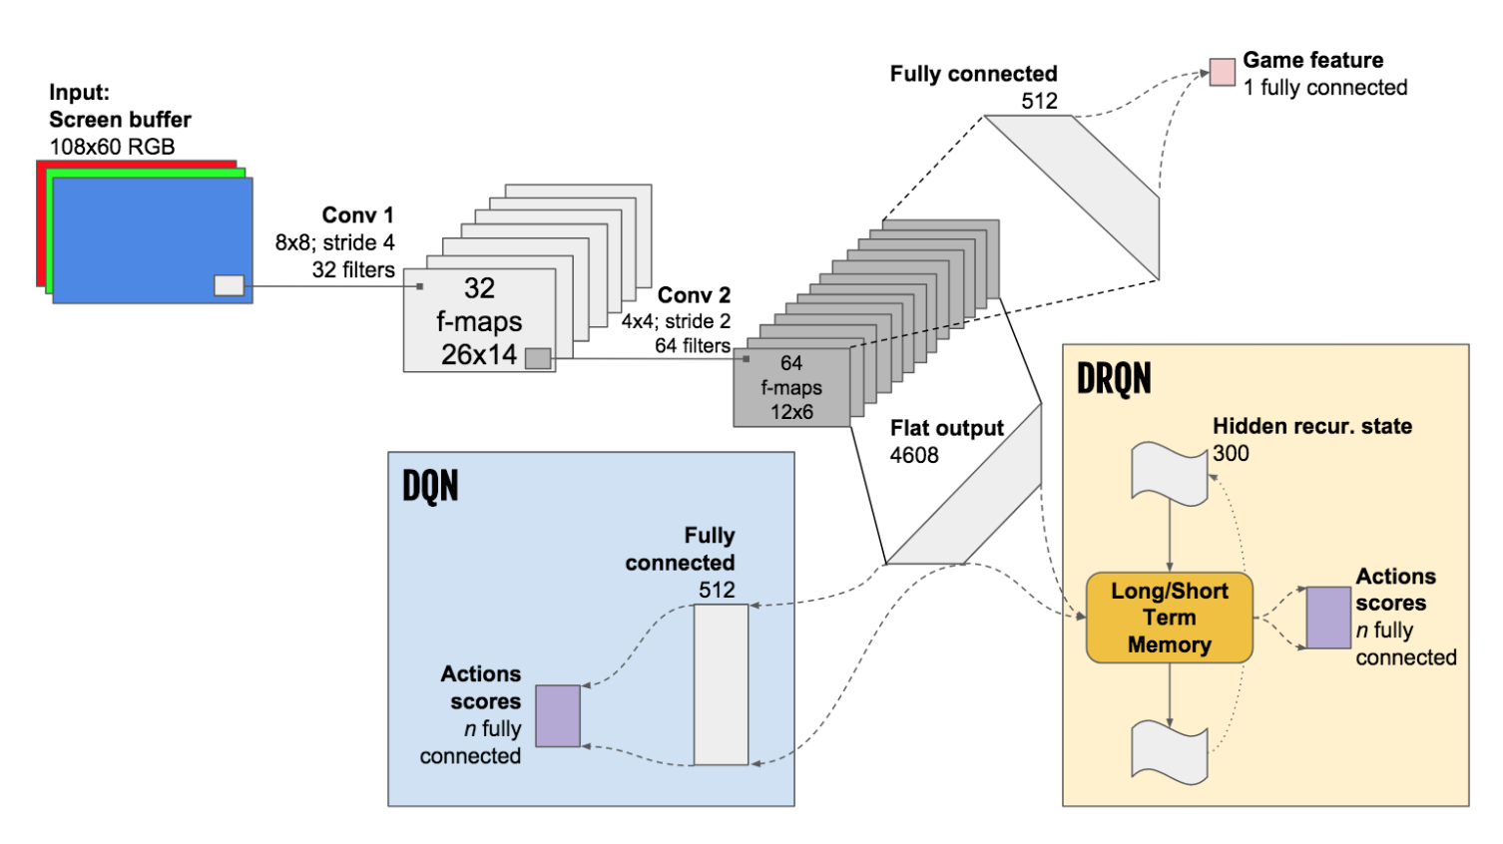
Future work

Slide 14
Conclusions
Deep Reinforcement Learning
Q learning
DQN
Training a robot to play a video game

